Slide 1
MODULE 2: BASELINE ASSESSMENT
Session 6: The Reference Year
Notes:
The Reference Year

Slide 2
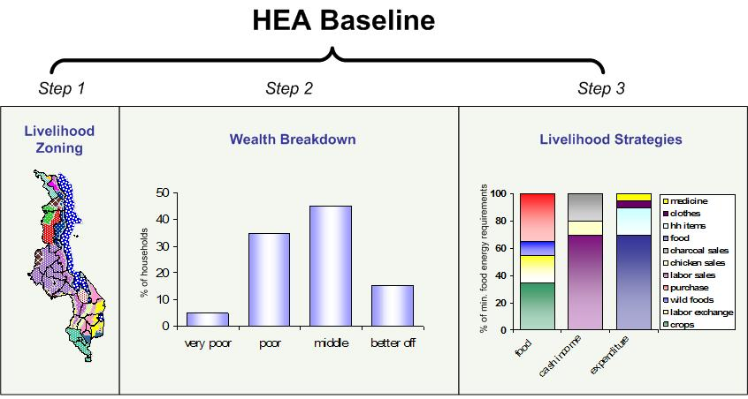
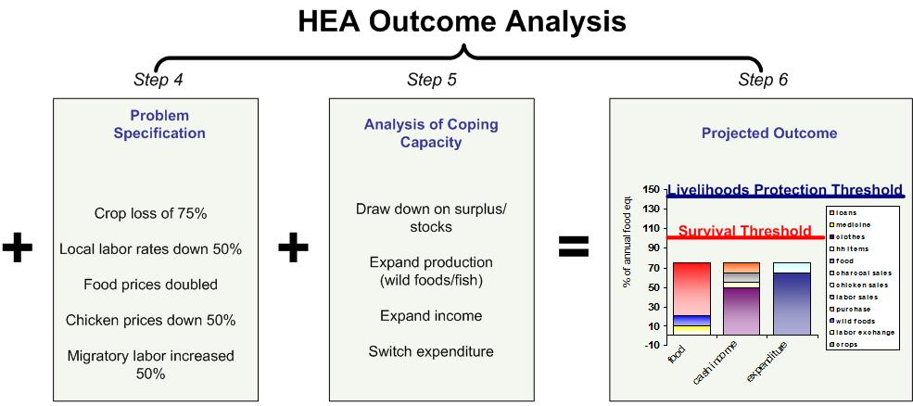
What is a Reference Year?
A reference year is the timeframe to which the baseline information applies
Session 6: The Reference Year
Notes:
The Reference Year

Slide 3
What is a Reference Year?
It also provides the starting point for HEA outcome analysis
Session 6: The Reference Year
Notes:
The Reference Year

Slide 4
How is a Reference Year Used?
All values in the HEA baseline are linked to the reference year.
This allows the analyst to calculate changes in access to food and cash income from year to year.
Session 6: The Reference Year
Notes:
The Reference Year

Slide 5
How is a Reference Year Used?
It also facilitates linkages between the HEA baseline and other (Government, UN, NGO) monitoring datasets.
Session 6: The Reference Year
Notes:
The Reference Year

Slide 6
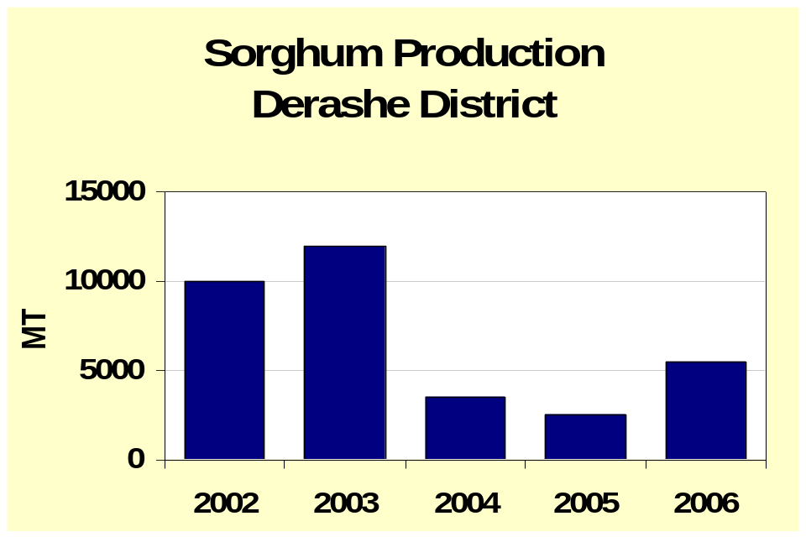
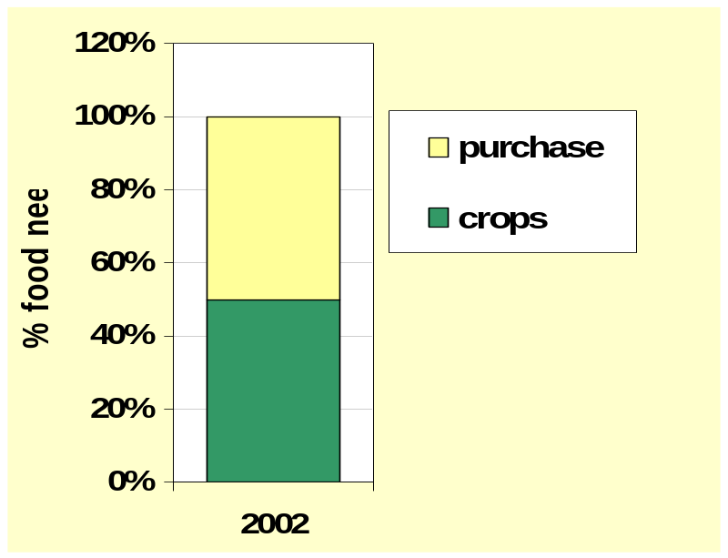
How is a Reference Year Used?
For instance….
Sorghum Production: District A
HEA Baseline
Session 6: The Reference Year
Notes:
The Reference Year

Slide 7
How is a Reference Year Used?
For instance….
Sorghum Production: District A
To calculate the change in access to food in 2006, the data from 2006 is compared to the reference year.
Sorghum production (‘000 MT)
2002 2003 2004 2005 2006
10 12 3.5 2.5 5.5
Session 6: The Reference Year
Notes:
The Reference Year

Slide 8
How is a Reference Year Used?
For instance….
Sorghum Production: District A
So the 2006 problem specified for sorghum would be:
5.5 / 10 x 100 = 55%
Sorghum production (‘000 MT)
2002 2003 2004 2005 2006
10 12 3.5 2.5 5.5
Session 6: The Reference Year
Notes:
The Reference Year

Slide 9
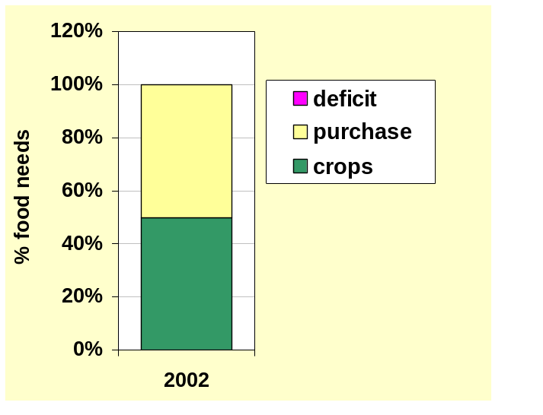
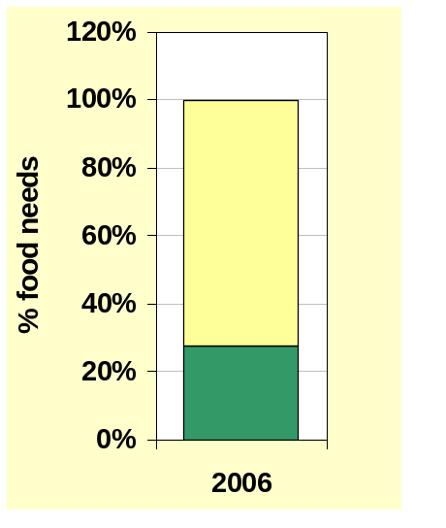
How is a Reference Year Used?
For instance….
HEA Baseline
Outcome Analysis
And the 2006 outcome analysis would show a decrease in crops relative to purchase.
Sorghum production (‘000 MT)
2002 2003 2004 2005 2006
10 12 3.5 2.5 5.5
Session 6: The Reference Year
Notes:
The Reference Year

Slide 10
How is a Reference Year Used?
For instance….
Sorghum Production: District A
If the reference year was 2004 rather than 2002, the problem would be:
5.5 / 3.5 x 100 = 157%
Sorghum production (‘000 MT)
2002 2003 2004 2005 2006
10 12 3.5 2.5 5.5
Session 6: The Reference Year
Notes:
The Reference Year

Slide 11
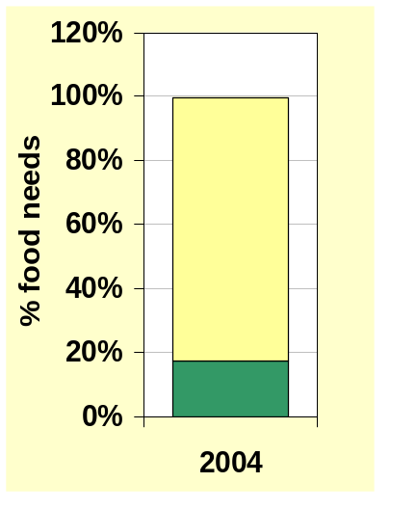
How is a Reference Year Used?
For instance….
HEA Baseline
Outcome Analysis
And the 2006 outcome analysis would show an increase in crops relative to purchase.
Sorghum production (‘000 MT)
2002 2003 2004 2005 2006
10 12 3.5 2.5 5.5
Session 6: The Reference Year
Notes:
The Reference Year

Slide 12
Choosing a Reference Year
The options are:
Average year Understood at village level?
Normal year Can be understood to mean good (i.e without drought or pests), i.e. a long time ago!
Typical year Most frequent, most common
Specific year How far back can people remember accurately?
Session 6: The Reference Year
Notes:
The Reference Year

Slide 13
Choosing a Reference Year
The simplest in terms of the field work is either last year or the year before (i.e. a specific recent year)
…provided it was not a very good year
…or a year with a lot of food aid
…or a year with a lot of conflict
Session 6: The Reference Year
Notes:
The Reference Year

Slide 14
Choosing a Reference Year
Otherwise take a year that can be considered typical of
the last 5-10 years
Session 6: The Reference Year
Notes:
The Reference Year

Slide 15
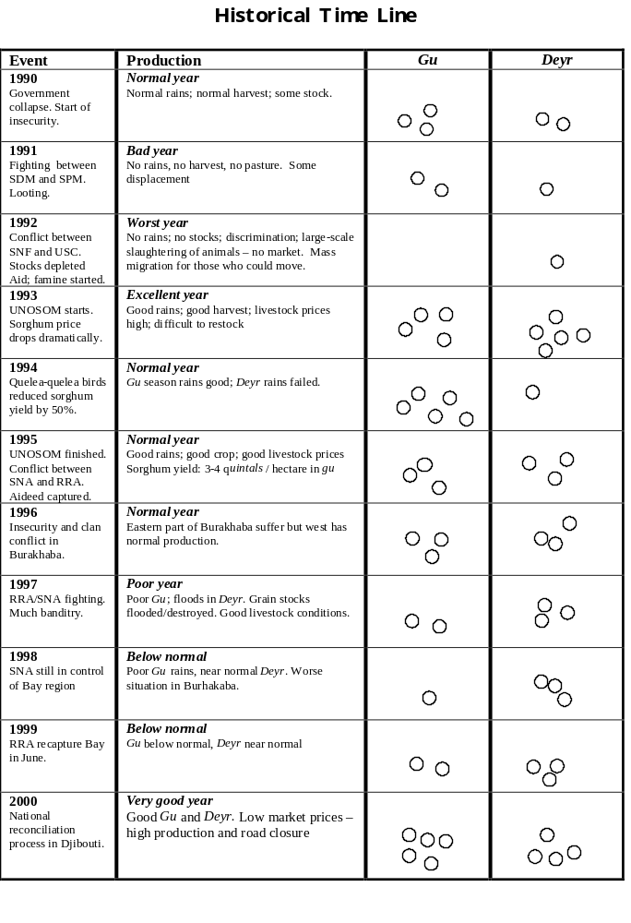
Choosing a Reference Year
A timeline can help set the context:
Session 6: The Reference Year
Notes:
The Reference Year

Slide 16
Setting up the Reference Year
In HEA the year starts at the end of the annual ‘hungry season’, or at the beginning of the consumption year
For agriculturalists this means the start of the main harvest
For pastoralists this means the start of the main rains
Session 6: The Reference Year
Notes:
The Reference Year

